Slide 1


Finding your {HomeAway} from home
Atindra Bandi | Amy Dang | Teeru Gupta | Hope Knopf | Jihyun Lee

Slide 2
Objectives of the project
As data scientists at HomeAway, how can we help property owners better understand different renters’ needs and how can we improve the experience for renters?
What attributes are most frequently mentioned in renters’ reviews?
How closely do the property descriptions match the reviews?
How can we improve property recommendations based on customer sentiments?
Notes:
RENTERS: WHAT’S MOST IMPORTANT → LIST OF PROPERTY WITH HIGHEST COSINE SIMILARITY
HOME OWNERS: COSINE MISMATCH → UPDATE DESCRIPTION (PAGE RANK)
Topic modeling
Cosine similarity
Sentiment analysis

Slide 3
Dataset Overview
277 properties in Austin
7, 796 reviews
Metadata
Property Link
Rating (5-scale) : Mostly in range from 4 to 5
Date
Review Tagline (Title)
Comments
Property Description
INTRODUCTION
REVIEW TOPICS
DESCRIPTION MATCHING
CUSTOMER SENTIMENTS
RECOMMENDATIONS

Slide 4
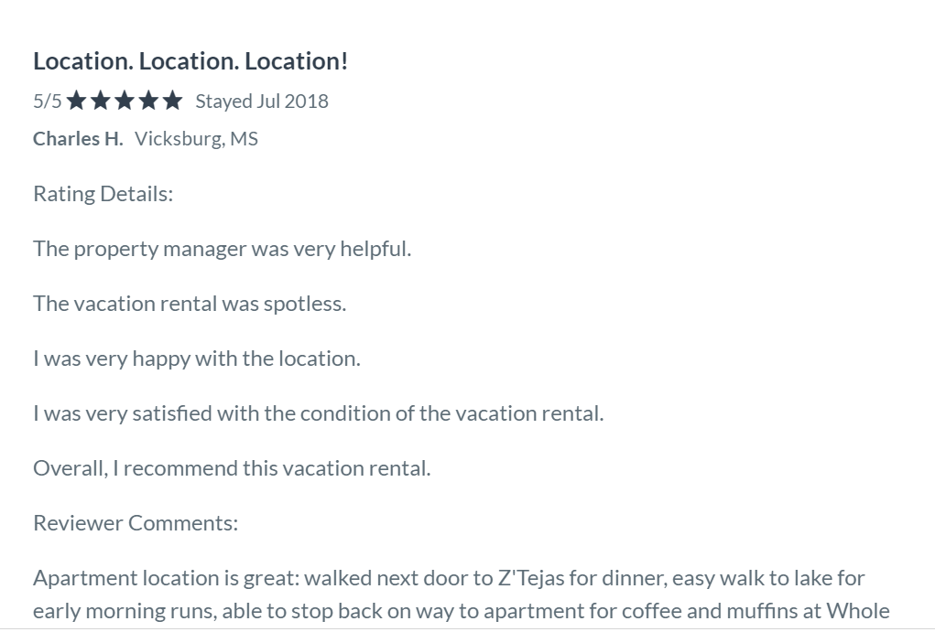
Data Preprocessing
After scraping reviews and property descriptions from HomeAway:
Removed punctuation, stop words
Lemmatized the word corpus
Removed properties from Turnkey
Property management company
Template
Remove properties with less than 5 reviews
Parse + / - 4 words for sentiment analysis
INTRODUCTION
REVIEW TOPICS
DESCRIPTION MATCHING
CUSTOMER SENTIMENTS
RECOMMENDATIONS

Slide 5

INSERT COOL PICTURE
What attributes are most frequently mentioned in renters’ reviews?

Slide 6




Topic Modeling
HOME SIZE
SURROUNDINGS
AMENITIES
LOCATION
family
group
plenty
space
friends
party
large
spacious
house
weekend
lake
comfortable
quiet
wonderful
beautiful
lovely
barton
springs
kitchen
room
bed
bathroom
towels
living
bedroom
TV
shower
parking
bedrooms
dryer
pool
downtown
restaurants
walk
close
south
congress
6th
street
distance
food
shops
town
bars
INTRODUCTION
REVIEW TOPICS
DESCRIPTION MATCHING
CUSTOMER SENTIMENTS
RECOMMENDATIONS
Notes:
High alpha (topic density), low beta (word density)
Home size, surroundings, amenities, location

Slide 7
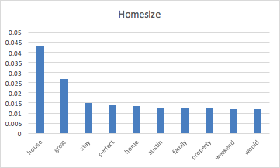
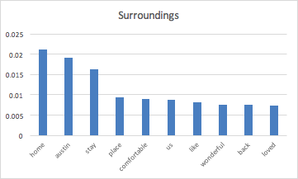
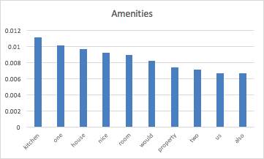
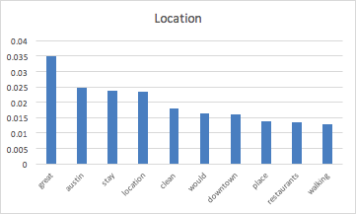
Most Popular Words for Topics
INTRODUCTION
REVIEW TOPICS
DESCRIPTION MATCHING
CUSTOMER SENTIMENTS
RECOMMENDATIONS
Notes:
-Choose topic which has highest probability for each property
-Took topic with maximum probability for LDA

Slide 8

INSERT COOL PICTURE
How closely do the descriptions match the reviews?

Slide 9
 |  | ‘Home Size’ predicted by topic modeling
 |  | No | Yes
‘Home Size’ predicted by Cosine Similarity | No | 75 | 45
 | Yes | 38 | 29
 |  | ‘Surroundings’ predicted by topic modeling
 |  | No | Yes
‘Surroundings’ predicted by Cosine Similarity | No | 149 | 18
 | Yes | 17 | 3
 |  | ‘Amenities’ predicted by topic modeling
 |  | No | Yes
‘Amenities’ predicted by Cosine Similarity | No | 157 | 14
 | Yes | 13 | 3
 |  | ‘Location’ predicted by topic modeling
 |  | No | Yes
‘Location predicted by Cosine Similarity | No | 69 | 34
 | Yes | 43 | 41
INTRODUCTION
REVIEW TOPICS
DESCRIPTION MATCHING
CUSTOMER SENTIMENTS
RECOMMENDATIONS
Notes:
Cosine similarity of topic to descriptions

Slide 10

INSERT COOL PICTURE
How can we improve property recommendations based on customer sentiments?
Notes:
After we matched the property descriptions with customer reviews, we had our recommendation system ready. But since cosine similarity could be high for negative association as well, we needed to consider sentiments of the review as well. Sentiment analysis was performed for each topic by replacing the vector of words by one word and as Amy mentioned earlier, the range we considered was 4 words around the topic word

Slide 11


Sentiment Analysis of Topics
Recommendation per topic
Customer Sentiment Score
Cosine
Similarity
Preference Score
INTRODUCTION
REVIEW TOPICS
DESCRIPTION MATCHING
CUSTOMER SENTIMENTS
RECOMMENDATIONS
Notes:
So to improve our recommendations, we came up with a preference score which was a product of cosine similarity and sentiment analysis. Recommendation per topic:
Customer sentiment score x cosine similarity = preference score

Slide 12
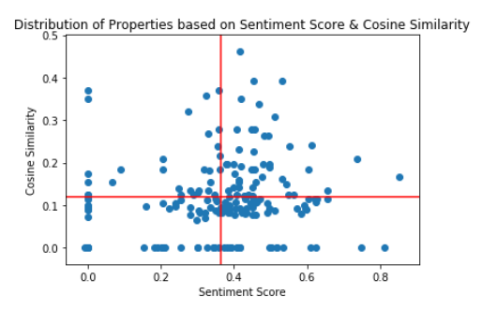
Recommendation based on Preference Score
INTRODUCTION
REVIEW TOPICS
DESCRIPTION MATCHING
CUSTOMER SENTIMENTS
RECOMMENDATIONS
Notes:
So this is how we are using the preference score. Based on threshold we will recommend properties in the first quadrant that is high positive sentiments and high similarity score

Slide 13
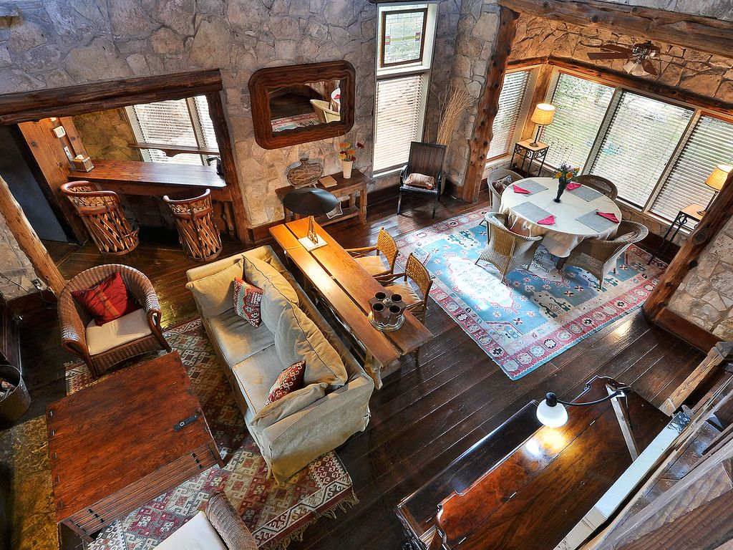


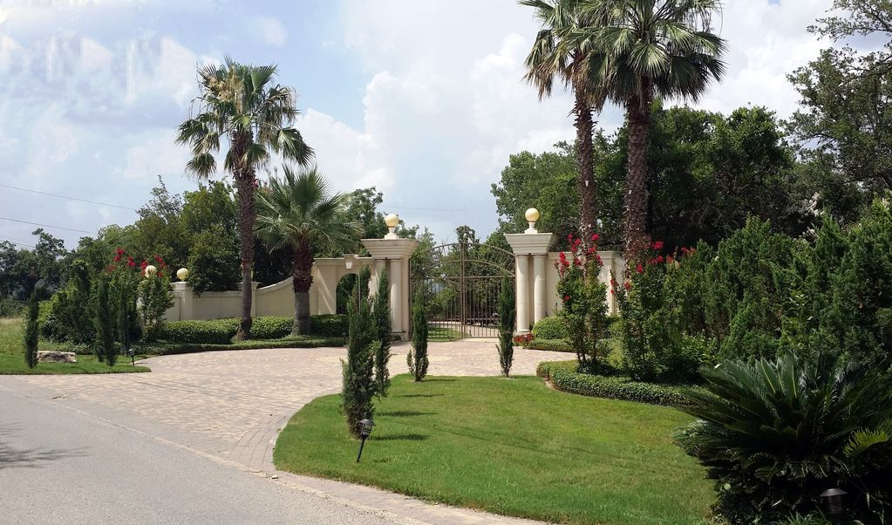
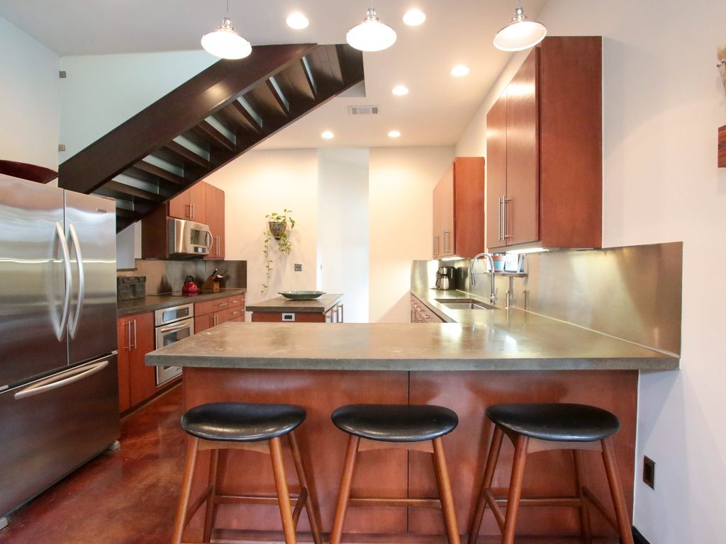
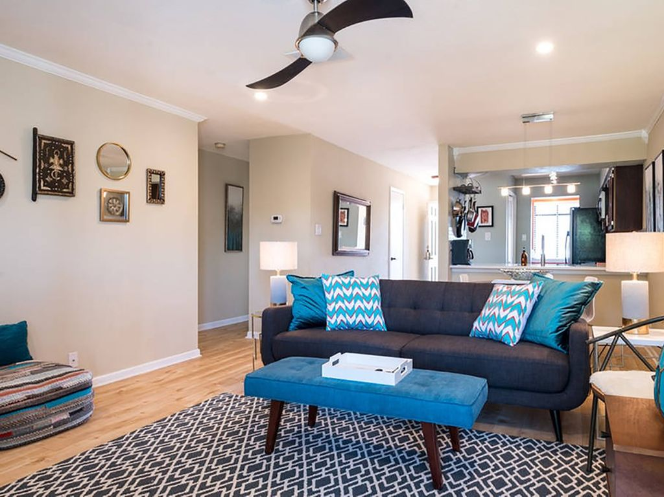

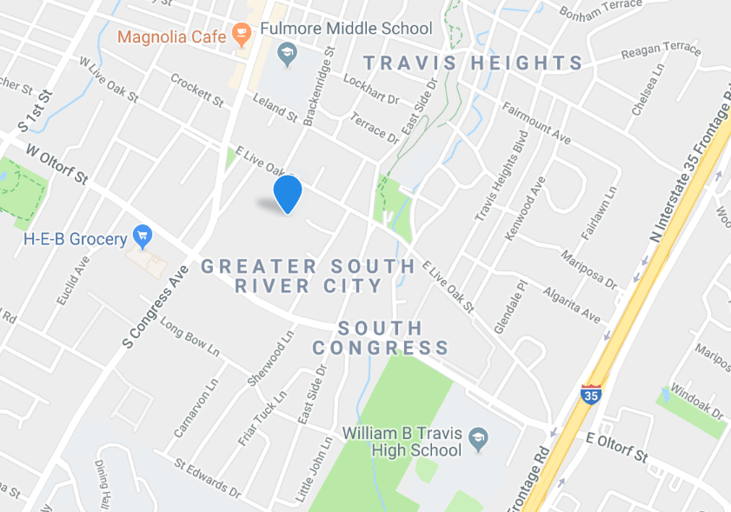
HOME SIZE
SURROUNDINGS
AMENITIES
LOCATION
INTRODUCTION
REVIEW TOPICS
DESCRIPTION MATCHING
CUSTOMER SENTIMENTS
RECOMMENDATIONS
Notes:
These are the pictures from the top property that we got for each of the topic using preference score. And as you can see from the pictures, we do get a close match with the topic the customer is looking out for

Slide 14



Recommendations
Align ‘Expectations Vs. Reality’
Update descriptions
Recommend homes based on “Preference Score”
INTRODUCTION
REVIEW TOPICS
DESCRIPTION MATCHING
CUSTOMER SENTIMENTS
RECOMMENDATIONS
Notes:
Expectations vs. reality
What do people talk about the most in their reviews
Update descriptions for a higher match/page rank based
Recommend homes based on “Preference Score”

Slide 15
Thank you!
Questions?

Slide 16
Appendix

Slide 17
Property Link (Home Size) | Sentiment Score | Similarity Score | Sentiment X Similarity
https://www.homeaway.com/vacation-rental/p1087615vb#reviews | 0.66 | 0.13 | 0.09
https://www.homeaway.com/vacation-rental/p1146249vb#reviews | 0.54 | 0.15 | 0.08
https://www.homeaway.com/vacation-rental/p3726987#reviews | 0.42 | 0.19 | 0.08
https://www.homeaway.com/vacation-rental/p3691456#reviews | 0.66 | 0.11 | 0.07
https://www.homeaway.com/vacation-rental/p1229301vb#reviews | 0.63 | 0.11 | 0.07
https://www.homeaway.com/vacation-rental/p165335vb#reviews | 0.62 | 0.11 | 0.07
https://www.homeaway.com/vacation-rental/p3598735#reviews | 0.61 | 0.11 | 0.07
https://www.homeaway.com/vacation-rental/p1041991vb#reviews | 0.62 | 0.11 | 0.07
https://www.homeaway.com/vacation-rental/p169977#reviews | 0.33 | 0.18 | 0.06

Slide 18
Property Link (Surroundings) | Sentiment Score | Similarity Score | Sentiment X Similarity
https://www.homeaway.com/vacation-rental/p293833#reviews | 0.51 | 0.31 | 0.16
https://www.homeaway.com/vacation-rental/p3538155#reviews | 0.47 | 0.34 | 0.16
https://www.homeaway.com/vacation-rental/p330221#reviews | 0.55 | 0.24 | 0.13
https://www.homeaway.com/vacation-rental/p321912vb#reviews | 0.33 | 0.36 | 0.12
https://www.homeaway.com/vacation-rental/p292796#reviews | 0.50 | 0.19 | 0.09
https://www.homeaway.com/vacation-rental/p3557534#reviews | 0.33 | 0.27 | 0.09
https://www.homeaway.com/vacation-rental/p3734684#reviews | 0.36 | 0.24 | 0.09
https://www.homeaway.com/vacation-rental/p186314vb#reviews | 0.45 | 0.14 | 0.06
https://www.homeaway.com/vacation-rental/p3633840#reviews | 0.41 | 0.14 | 0.06

Slide 19
Property Link (Amenities) | Sentiment Score | Similarity Score | Sentiment X Similarity
https://www.homeaway.com/vacation-rental/p3491296#reviews | 0.53 | 0.16 | 0.09
https://www.homeaway.com/vacation-rental/p370200vb#reviews | 0.46 | 0.18 | 0.08
https://www.homeaway.com/vacation-rental/p375283#reviews | 0.36 | 0.22 | 0.08
https://www.homeaway.com/vacation-rental/p1105255vb#reviews | 0.46 | 0.15 | 0.07
https://www.homeaway.com/vacation-rental/p272323#reviews | 0.41 | 0.15 | 0.06
https://www.homeaway.com/vacation-rental/p3479083#reviews | 0.45 | 0.12 | 0.05
https://www.homeaway.com/vacation-rental/p3620287#reviews | 0.57 | 0.09 | 0.05
https://www.homeaway.com/vacation-rental/p1258754vb#reviews | 0.33 | 0.13 | 0.04
https://www.homeaway.com/vacation-rental/p3525767#reviews | 0.41 | 0.11 | 0.04

Slide 20
Property Link (Locations) | Sentiment Score | Similarity Score | Sentiment X Similarity
https://www.homeaway.com/vacation-rental/p324951vb#reviews | 0.53 | 0.39 | 0.21
https://www.homeaway.com/vacation-rental/p344148#reviews | 0.42 | 0.46 | 0.19
https://www.homeaway.com/vacation-rental/p1099816vb#reviews | 0.45 | 0.39 | 0.18
https://www.homeaway.com/vacation-rental/p282773#reviews | 0.74 | 0.21 | 0.15
https://www.homeaway.com/vacation-rental/p1308945vb#reviews | 0.61 | 0.24 | 0.15
https://www.homeaway.com/vacation-rental/p223235vb#reviews | 0.42 | 0.35 | 0.15
https://www.homeaway.com/vacation-rental/p3607280#reviews | 0.85 | 0.17 | 0.14
https://www.homeaway.com/vacation-rental/p3480367#reviews | 0.36 | 0.37 | 0.13
https://www.homeaway.com/vacation-rental/p1258756vb#reviews | 0.49 | 0.26 | 0.13

